Slide 1
The 4 Steps to Answering a Document-based Question (DBQ)
At NACA

Slide 2
What is a DBQ?
A DBQ is a document-based question that asks you to make sense out of a couple of historical documents.
A document might be a short reading, a photograph, or any other historical artifact that tells us something about the people, places or events of the past.

Slide 3
Step 1: Read the Document (of course)
Read the whole document.
Examine all of the text features of the document such as bold print, words in italics, pictures, website links, graphs and more. Text features tell the reader to pay attention to certain parts of the text for important information or instructions. Text features help our brain understand the document.
As you read, annotate your document by using the NACA annotation guide!

Slide 4
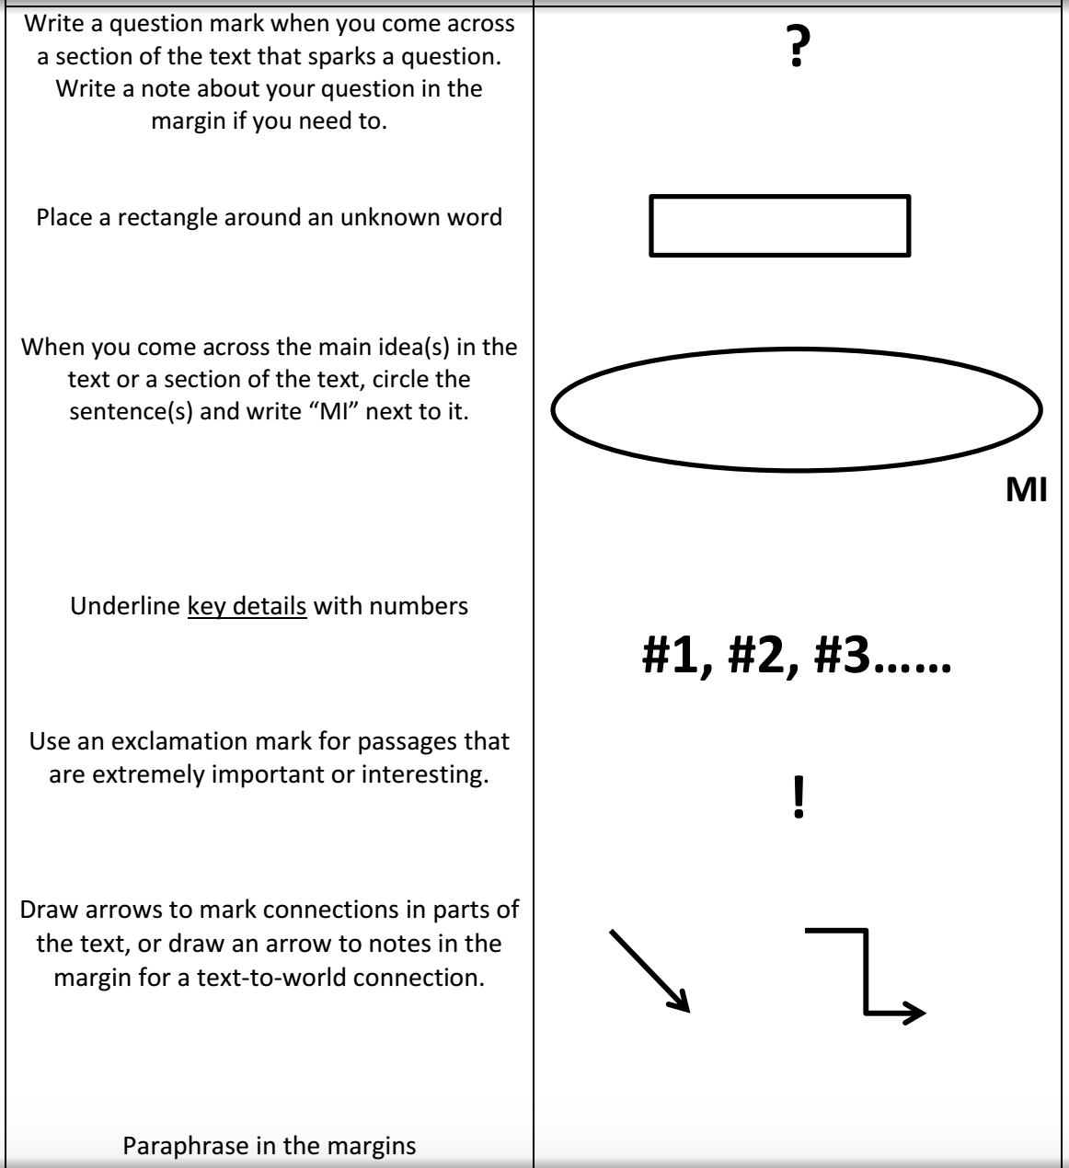
The NACA Annotation Guide

Slide 5
Step 2: Draft an Answer to the Document-based Question (DBQ)
Write a draft answer to the DBQ.
Remember that this is a brainstorm, so write what comes to your mind without stressing.

Slide 6
Step 3 - Write 3 Sub-Questions
Sub-questions are small questions that will help you dissect the DBQ.
How do you do this? Find and underline the nouns in your DBQ. For each noun, write a question you have about that noun. Check out the example:
---------------------------------------------------------------------------------------Why Sub-Questions?
The more you practice Sub-Questions the better you will be at thinking and solving problems in the real world!
EXAMPLE
DBQ: Why do people in India, a large country, practice many different religions?
Sub-Question: What religions are there in India?

Slide 7
DBQs and Sub-Questions
DBQ: Why do people in India, a large country, practice many different religions?
Sub-Question 1:
What do the artifacts tell me about the people in India?
Sub-Question 2:
What do I know about the country?
Sub-Question 1:
What do I know about the religions of India?

Slide 8
Step 4 - Answer Your Sub-Questions
First
Answer all three of your sub-questions.
Why? Your answers will help you to write your final DBQ answer.
Second
Go back to your first DBQ answer.
Now you have your three sub-questions, and your answer to those questions, do write your final DBQ answer.

Slide 9
Remember Your Sentence Starters!
On page ____, it said…
The author wrote…
The graphic/picture showed…
An example is…
In the text ________, it said…
I know this because...

